Slide 1

Effect of waste water on concrete mixing and curing
Under the Guidance of
Dr. D Bharath Kumar
Assistant professor, Department of Civil Engineering
J. Ravi Varma - 160120732092
G. Naveen - 160120732088
BATCH No- 216 DBK
N. Yathin - 160120732117

Slide 2
Contents
Aim and Objectives
Methodology
Results and Discussion
Conclusion

Slide 3
Aim and objective
Aim :
The main aim of the study is to find the optimum combination of wastewater & potable water which could yield better concrete properties (strength properties).
Objectives:
To investigate the chemical properties of raw wastewater.
In the casting and curing process of cubes, various percentages of wastewater(0%, 25%, 50%, 75% and 100%) are substituted for freshwater, allowing for the examination of the effect on cubes containing 0% and 100% wastewater as replacement for 100% freshwater.
To investigate mechanical strength parameters of concrete casted and cured with wastewater.

Slide 4
Methodology
Literature Review
Objective finalization
pH
Wastewater collection and chemical analysis.
Alkalinity
Material procurement for casting and curing
Chlorides
Compressive strength test
Total solids
Experimentation
Result interpretation
Tensile strength test

Slide 5
Summary of the Methodology
In a study focused on utilizing wastewater in concrete production, raw wastewater samples were collected from five points along the Musi River (Osman Sagar), designated as S1 to S5. Chemical analysis of the wastewater determined various parameters including chlorides, alkalinity, hardness, pH, electrical conductivity (EC), and total solids. The most suitable collection point was identified based on prior research. Subsequently, the necessary raw materials were gathered, and a mix design for M25 grade concrete was formulated. Concrete mixes were prepared by replacing water with wastewater at different proportions (0%, 25%, 50%, 75%, 100%), with curing conducted using either normal water or 100% wastewater depending on the wastewater content. Specimens including cubes, cylinders, and prisms were cast and cured for 28 days, followed by tests to evaluate their properties. Analysis of the test results facilitated drawing conclusions regarding the efficacy and potential of incorporating wastewater in concrete production, shedding light on its impact on various concrete properties and the optimal utilization strategies.

Slide 6
Results and discussions
Site map

Slide 7
Material Properties:
Wastewater properties
Table i Chemical Analysis on wastewater
S.NO | Parameter(mg/l) | S1 (Gandipet lake) | S2 (NRB) | S3 (SRB) | S4 (Attapur p.no 114) | S5 (Golnaka bridge) | Standards for water used in Concrete
1 | pH* | 7.35 | 7.36 | 7.48 | 7.32 | 7.37 | 6.5-8.5
2 | Alkalinity | 227.5 | 275 | 475 | 460 | 455 | 2000
3 | Chlorides | 47.48 | 87.47 | 149.95 | 154.95 | 173.69 | 500-2000
4 | Hardness | 93.75 | 105 | 145 | 147 | 150
5 | TS | 1600 | 3330 | 2490 | 1900 | 3400 | 5000
6 | TDS | 900 | 2400 | 1790 | 1600 | 1800 | -
7 | TSS | 700 | 930 | 700 | 300 | 1600 | -
8 | EC | 1348 | 1368 | 1287 | 1297.5 | 1301 | -
* | No units
# | µS/cm

Slide 8
Concrete properties

Slide 9
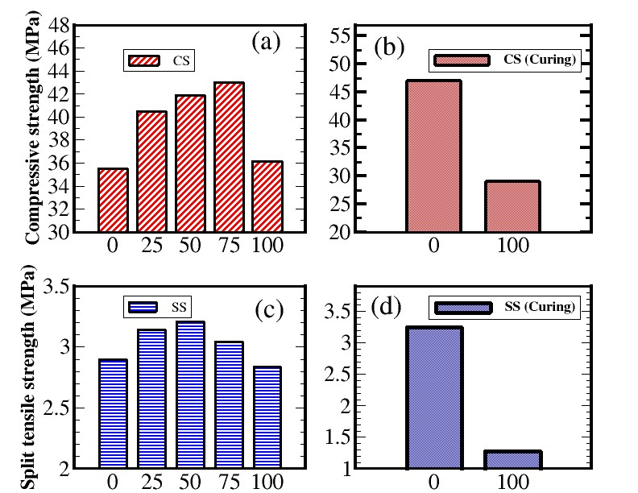
Table ii Compressive strength of Concrete Cube
Strength properties
S.NO | Mix CODE | Cube - 28 days (N/mm²)
1. | WW0CA0CU | 35.5
2. | WW25CA0CU | 40.5
3. | WW50CA0CU | 41.85
4. | WW75CAOCU | 43
5. | WW100CA0CU | 36.13
6. | WW0CA100CU | 47
7. | WW100CA100CU | 29
Table iii Split Tensile Strength of Concrete Cylinder
S.NO | Mix CODE | Cylinder – 28 days (N/mm²)
1. | WW0CAOCU | 2.9
2. | WW25CA0CU | 3.14
3. | WW50CA0CU | 3.21
4. | WW75CA0CU | 3.04
5. | WW100CA0CU | 2.84
6. | WW0CA100CU | 3.25
7. | WW100CA100CU | 1.27

Slide 10
Conclusion
Based on the investigations conducted on hardened state properties of concrete containing wastewater as partial and full replacement to portable water in casting and curing, the following conclusions are drawn:
Research on the impact of wastewater on concrete properties, particularly compressive and split tensile strength, reveals intriguing trends. Concrete with no replacement in casting and full replacement in curing with portable water exhibits optimal compressive and split tensile strength, showcasing significant improvements compared to standard M25 mixes. The influence of total dissolved solids (TDS) content in water is pivotal; initially, increasing TDS enhances compressive strength by filling voids, but excessive TDS leads to instability and a subsequent decrease in strength. Concrete casted with wastewater displays a complex relationship, with partial replacement up to 75% enhancing strength by filling voids with dissolved contents, while 100% replacement diminishes strength due to excessive TDS. The optimal scenario involves casting with portable water and curing with 100% wastewater, maximizing strength by filling voids while avoiding excessive dissolved contents. Conversely, casting and curing both with 100% wastewater result in reduced strength due to the abundance of dissolved solids. This underscores the intricate interplay between water quality, replacement ratios, and concrete strength characteristics.

Slide 11
THANK YOU ..!

